Slide 1
Media on Foxes in Tasmania
David Obendorf, PhD

Slide 2
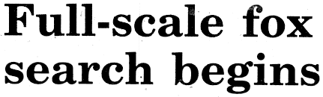
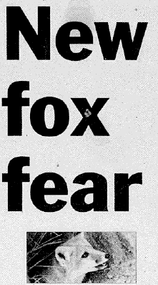
May 2001 – newspaper articles after claimed sightings at Burnie and Longford

Slide 3

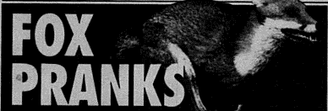
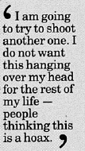
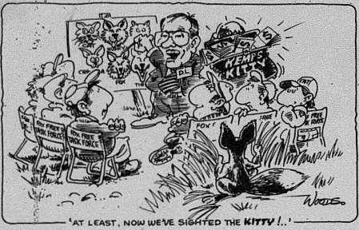
Mercury 22 June 2001
Woods cartoon - State Minister Llewellyn’s attempts to get federal funding for foxes
Examiner 19 April 2002
Mercury 12 July 2001

Slide 4
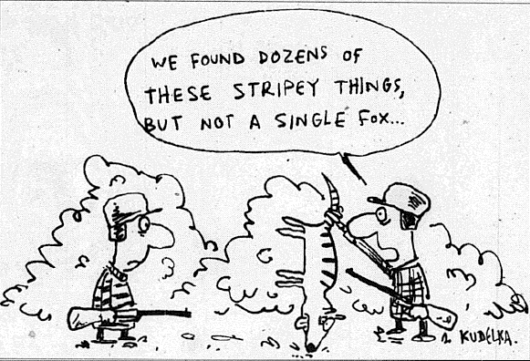
Mercury 16 June 2001- Kudelka cartoon

Slide 5
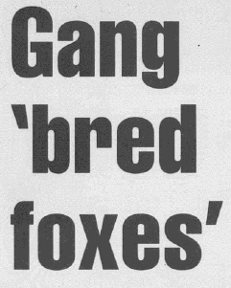

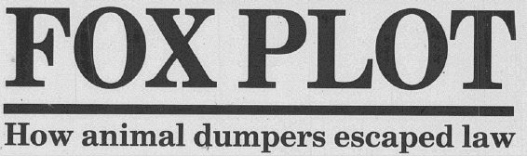
Advocate 23 March 2002
Sunday Examiner 7 October 2001
Mercury 5 June 2002

Slide 6
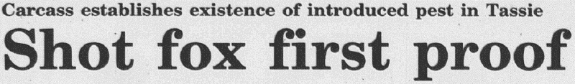
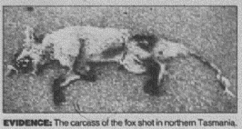
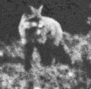


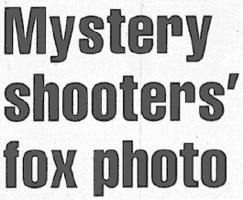
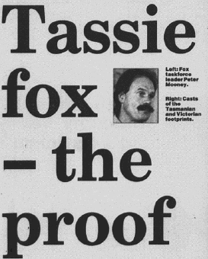
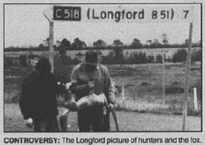

Mercury 28 September 2001
Examiner 17 July 2001
Advocate 14 August 2003
Mercury 23 August 2001

Slide 7
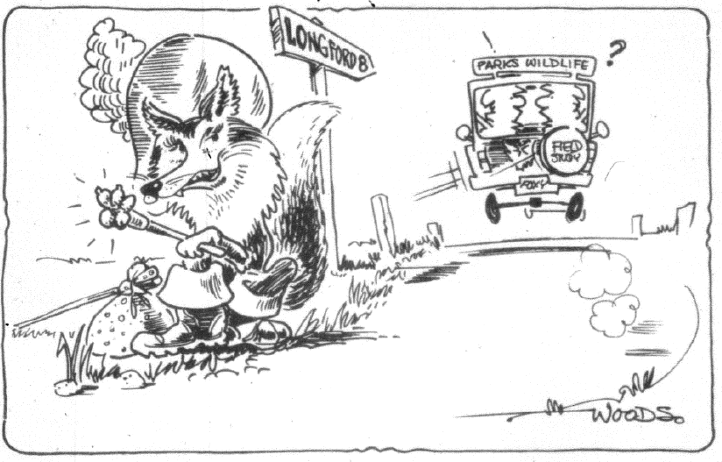
Examiner 24 August 2001 – after the report of the single foot print at Woodstock Lagoon, near Longford

Slide 8
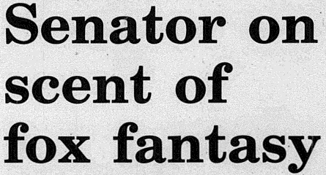
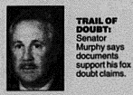
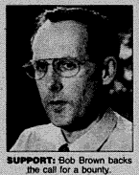
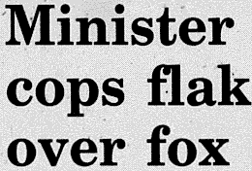

Mercury 10 July 2002
Mercury 28 January 2002
Mercury 25 January 2002

Slide 9
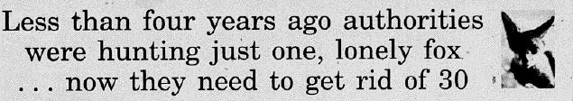
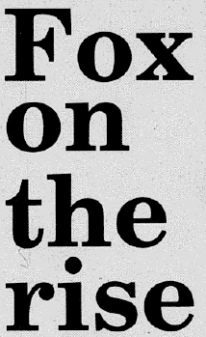


Mercury 24 January 2002
Mercury 28 January 2002
‘the sighting of fox cubs’ was not corroborated

Slide 10



Advocate 9 November 2003

Slide 11



A home-made barb-wire trap is alleged to have jagged a fox sufficient to draw blood which drops onto some wood framing but fails to catch any hairs.
The incriminating barb is not tested.
The use of fox urine at the site is not mentioned
A wood sample is derived from under the trap tests positive for fox DNA
Mercury 15 June 2006 – Old Beach chicken kill incident

Slide 12
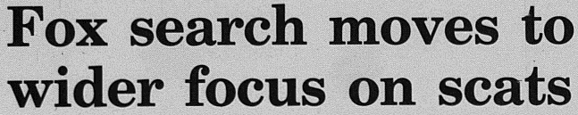




Mercury 22 November 2005 – first DNA fox positive scat

Slide 13
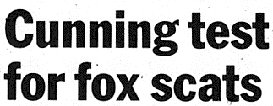


Examiner 7 January 2006 – funding to apply
DNA-fox scat technology to the Tasmanian Fox Program

Slide 14
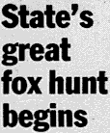
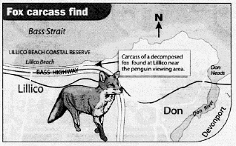


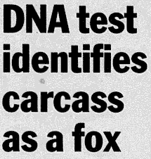

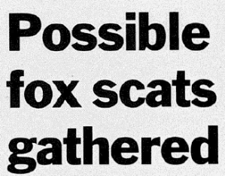

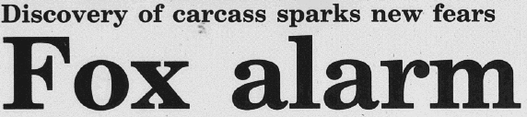
LILLICO DEAD FOX – Tasmanian media
28 February – 3 March 2006

Slide 15
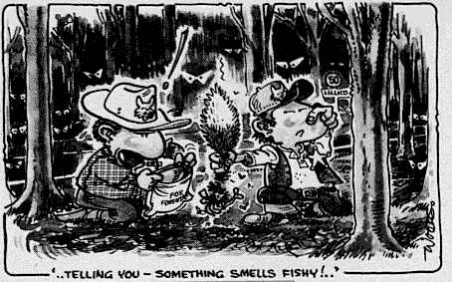
Examiner 1 March 2006 - cartoon after the Lillico dead fox discovery

Slide 16
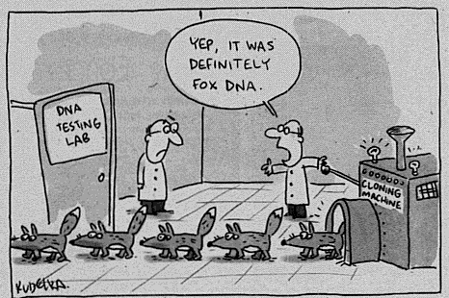
Mercury 14 June 2006 – Kudelka cartoon

Slide 17
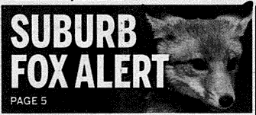
For a week the Mercury newspaper published daily articles on a claimed fox presence in an outer suburb of Hobart of Old Beach based on a suspicious chicken kill
Mercury 14 June 2006

Slide 18
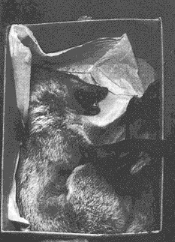



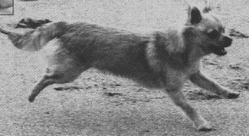
Mercury 17 October 2003
Advocate 18 December 2003
Advocate 19 December 2003

Slide 19
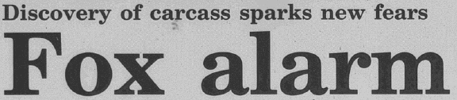

LILLICO DEAD FOX CUB
Mercury 28 February 2006

Slide 20
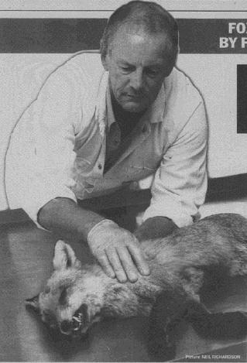
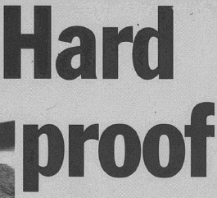

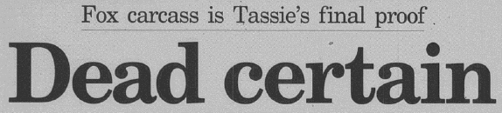

Dr Tony Peacock, is the CEO is the Invasive Animals Co-operative Research Centre. The Centre is the Commonwealth-funded think-tank on the nation’s feral animal populations. It comprises 43 groups, including 36 Australian Government agencies …. Dr Peacock says that Tasmania’s fox problem is real.
Mercury & Examiner front page – 1 August 2006
“Quite frankly it sounds like a fox has to come up to bite them on the bum before they will believe”, Dr Peacock said.
12 August 2006

Slide 21

BOSWORTH FOX MEDIA -

Slide 22

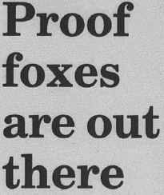

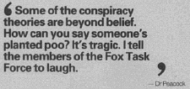

THE FIRST DNA-FOX POSITIVE SCAT FOUND AT CONARA
Mercury 24 September 2005

Slide 23
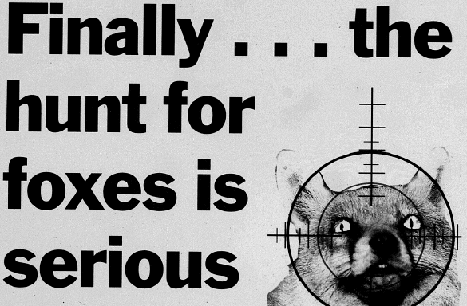
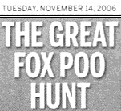
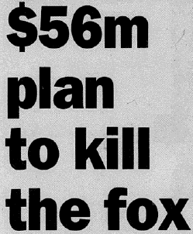
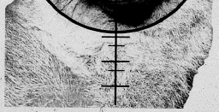
$56 million expenditure over 10 years on fox eradication
Increased 1080 baiting
Carnivore faeces hunts to detect foxes in the environment
Front pages of Tasmania’s 3 daily newspaper – 14 November 2006

Slide 24
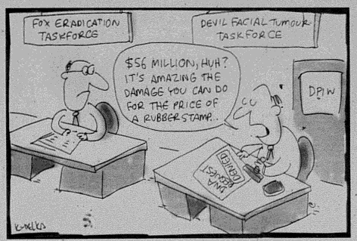
Competition for Commonwealth funding for Tasmania’s front-line biodiversity program s – Kudelka cartoon Mercury 14 November 2006

Slide 25
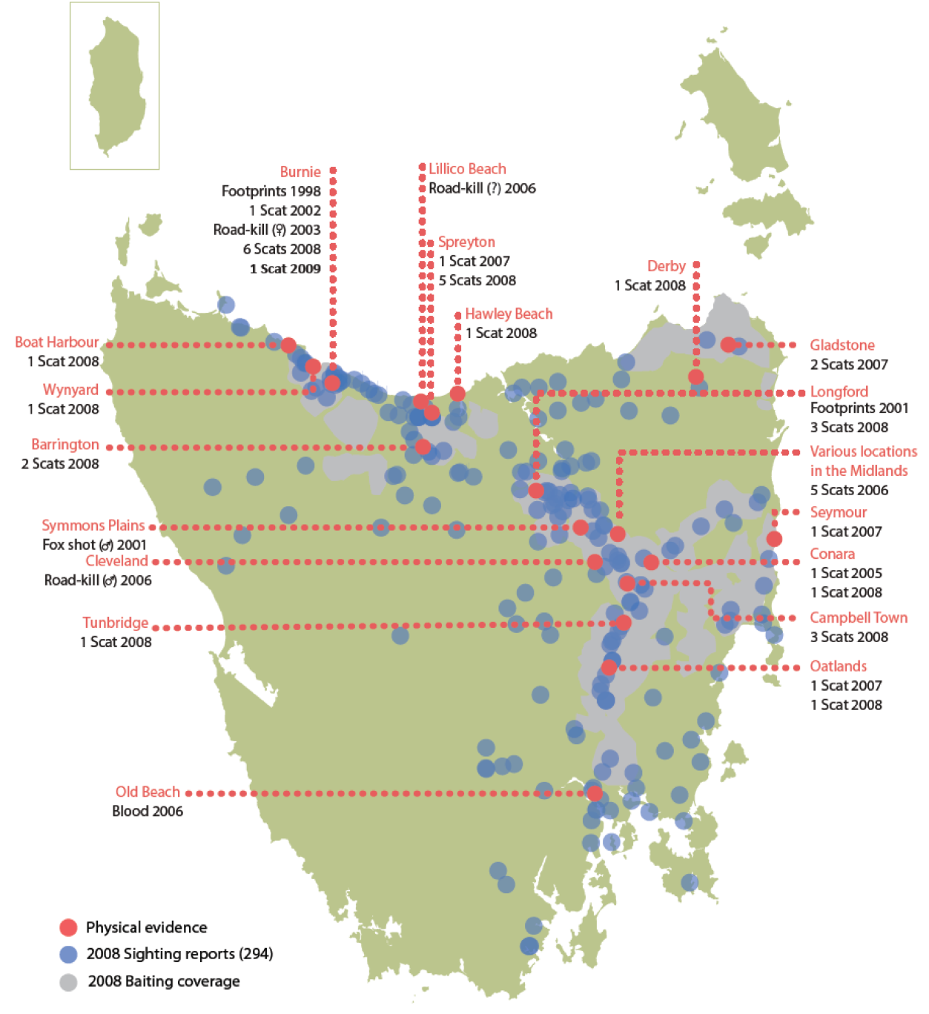
Sunday Tasmanian - 14 March 2010
PHYSICAL EVIDENCE OF FOXES IN TASMANIA
NOTE: BRUNY ISLAND SCAT NOT INCLUDED

Slide 26


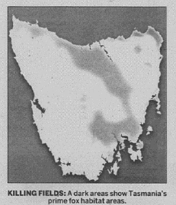
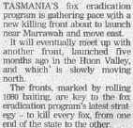
Mercury 11 October 2010

